Slide 1

Computer Organization & Assembly Language
Lecture-3
Register Transfer Language
Dr. Imtiaz Hussain
Professor
Department of Electrical and Computer Engineering
Iqra University, Karachi, Pakistan
email: imtiaz.hussain@iqra.edu.pk
Fall 2024

Slide 2
Today
Introduction
Register Transfer
Bus and Memory Transfer

Slide 3
Introduction
Digital system design invariably uses a modular approach.
The modules are constructed from digital components such as registers, decoders, arithmetic elements, and control logic.
The various mod­ules are interconnected with common data and control paths to form a digital computer system.

Slide 4
Introduction
Digital modules are best defined by the registers they contain and the operations that are performed on the data stored in them.
The operations executed on data stored in registers are called microoperations.
A microoper­ation is an elementary operation performed on the information stored in one or more registers.

Slide 5
Introduction
It is possible to specify the sequence of microoperations in a computer by explaining every operation in words, but this procedure usually involves a lengthy descriptive explanation.
It is more convenient to adopt a suitable symbology to describe the sequence of transfers between registers and the various arithmetic and logic microoperations associated with the transfers.
The use of symbols instead of a narrative explanation provides an organized and concise manner for listing the microoperation sequences in registers and the control functions that initiate them.

Slide 6
Introduction
The symbolic notation used to describe the microoperation transfers among registers is called a register transfer language (RTL).
The term "register transfer" implies the availability of hardware logic circuits that can perform a stated microoperation and transfer the result of the operation to the same or another register.
The word "language" is borrowed from programmers, who apply this term to programming languages.

Slide 7
Register Transfer
Computer registers are designated by capital letters (sometimes followed by numerals) to denote the function of the register.
For example, the register that holds an address for the memory unit is usually called a memory address register and is designated by the name MAR.
Other designations for registers are PC (for program counter), IR (for instruction register), and R1 (for processor register).

Slide 8
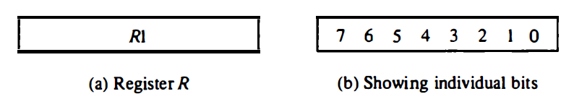
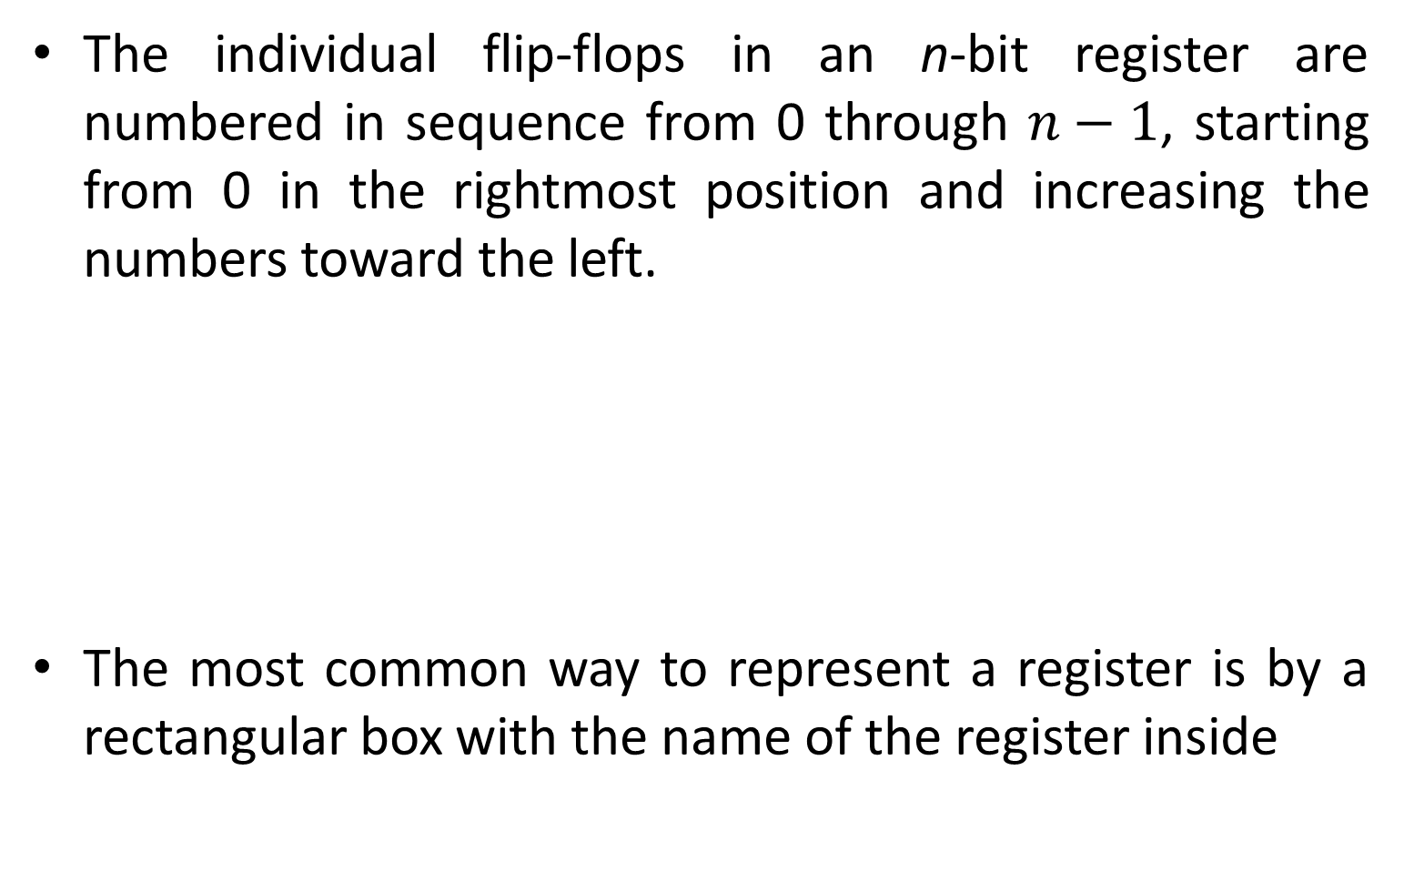
Register Transfer
The individual flip-flops in an n-bit register are numbered in sequence from 0 through $n−1$, starting from 0 in the rightmost position and increasing the numbers toward the left.
The most common way to represent a register is by a rectangular box with the name of the register inside

Slide 9
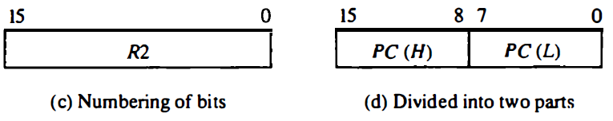
Register Transfer
The numbering of bits in a 16-bit register can be marked on top of the box.
A 16-bit register is partitioned into two parts in (d).
Bits 0 through 7 are assigned the symbol L (for low byte) and bits 8 through 15 are assigned the symbol H (for high byte).

Slide 10

Register Transfer
Information transfer from one register to another is designated in symbolic form by means of a replacement operator.
The statement
denotes a transfer of the content of register R1 into register R2.
The content of the source register R1 does not change after the transfer.

Slide 11

Register Transfer
Normally, we want the transfer to occur only under a predetermined control condition.
This can be shown by means of an if-then statement.
where P is a control signal generated in the control section.

Slide 12

Register Transfer
It is sometimes convenient to separate the control variables from the register transfer operation by specifying a control function.
A control function is a Boolean variable that is equal to 1 or 0.
The control function is included in the statement as follows:

Slide 13
Register Transfer
The control function is included in the statement as follows:
The control condition is terminated with a colon.
It symbolizes the requirement that the transfer operation be executed by the hardware only if P = 1.

Slide 14
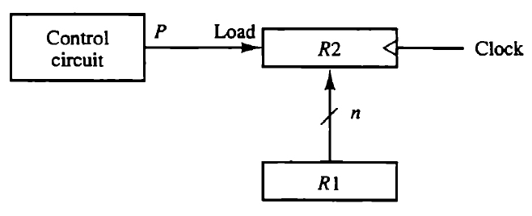
Register Transfer
The n outputs of register R1 are connected to the n inputs of register R2.
Register R2 has a load input that is activated by the control variable P.

Slide 15
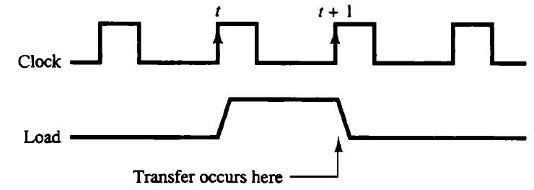
Register Transfer
The transfer will occur with every clock pulse transition while P remains active.

Slide 16
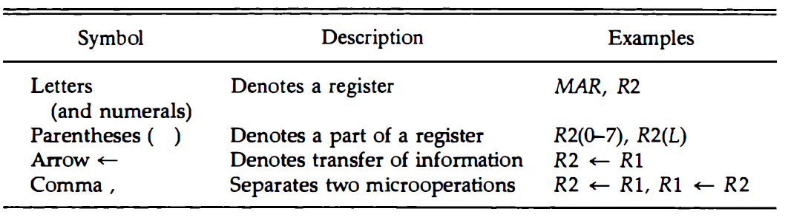
Register Transfer
The basic symbols of the register transfer notation are listed in table below.

Slide 17
Bus and Memory Transfer
A typical digital computer has many registers, and paths must be provided to transfer information from one register to another.
The number of wires will be excessive if separate lines are used between each register and all other registers in the system.
A more efficient scheme for transferring information between registers in a multiple-register configuration is a common bus system.
A bus structure consists of a set of common lines, one for each bit of a register, through which binary information is transferred one at a time.

Slide 18
Bus and Memory Transfer
Control signal determine which register is selected by the bus during each particular register transfer.
One way of constructing a common bus system is with multiplexers.
The multiplexers select the source register whose binary information is then placed on the bus.

Slide 19
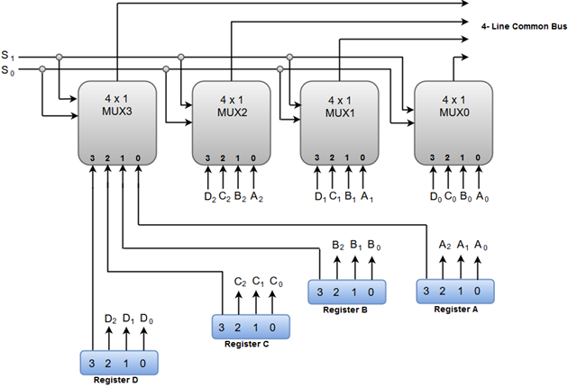
Bus and Memory Transfer
The construction of a bus system for four registers is shown.

Slide 20
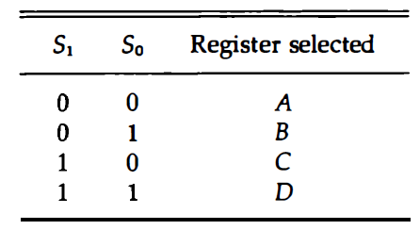
Bus and Memory Transfer
The selection lines choose the four bits of one register and transfer them into the four-line common bus.

Slide 21
Bus and Memory Transfer
In general, a bus system will multiplex k registers of n bits each to produce an n-line common bus.
The number of multiplexers needed to construct the bus is equal to n , the number of bits in each register.
For example, a common bus for eight registers of 16 bits each requires 16 multiplexers, one for each line in the bus.
Each multiplexer must have eight data input lines and three selection lines to multiplex one significant bit in the eight registers.

Slide 22

Bus and Memory Transfer
The transfer of information from a bus into one of many destination registers can be accomplished by connecting the bus lines to the inputs of all destination registers and activating the load control of the particular destination register selected.
The symbolic statement for a bus transfer may mention the bus or its presence may be implied in the statement.
When the bus is included in the statement, the register transfer is symbolized as follows:

Slide 23

Bus and Memory Transfer
The content of register C is placed on the bus, and the content of the bus is loaded into register R 1 by activating its load control input.
If the bus is known to exist in the system, it may be convenient just to show the direct transfer.
From this statement the designer knows which control signals must be activated to produce the transfer through the bus.

Slide 24
Three state Buffers
A bus system can be constructed with three-state gates instead of multiplexers.
A three-state gate is a digital circuit that exhibits three states.
Two of the states are signals equivalent to logic 1 and 0 as in a conventional gate. The third state is a high-impedance state.

Slide 25
Three state Buffers
The high-impedance state behaves like an open circuit, which means that the output is disconnected and does not have a logic significance.
Three-state gates may perform any conventional logic, such as AND or NAND.
However, the one most commonly used in the design of a bus system is the buffer gate.

Slide 26
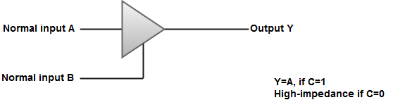
Three state Buffers
The high-impedance state of a three-state gate provides a special feature not available in other gates.
Because of this feature, a large number of three-state gate outputs can be connected with wires to form a common bus line without endangering loading effects.

Slide 27
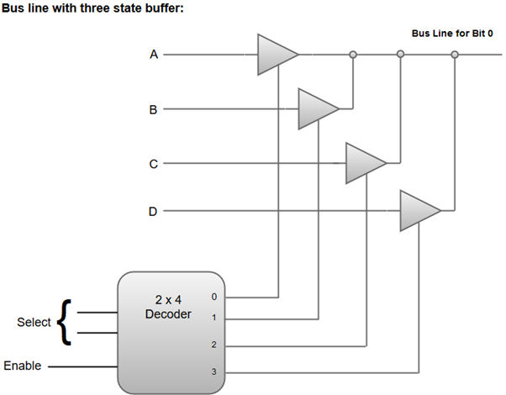
Bus System with Three State Buffers
The construction of a bus system with three-state buffers.

Slide 28
Bus System with Three State Buffers
To construct a common bus for four registers of n bits each using three-state buffers, we need n circuits with four buffers in each.

Slide 29
End of Lecture-3

